Slide 1
Energy Balance Over Oceans and Land

Slide 2
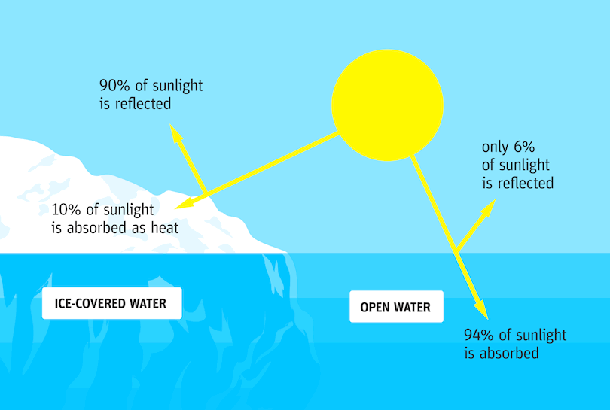
Temperature Difference
Water can absorb and emit a much larger amount of heat than land due to its high specific heat content.
Water = 4,200 J/kg/K
Rock = 2,000 J/kg/K
Vegetated land = 830 J/kg/K
Air = 700 J/kg/K

Slide 3
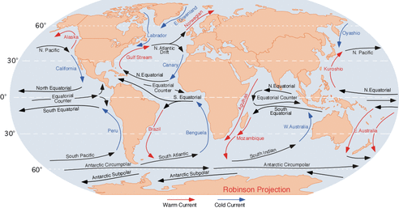
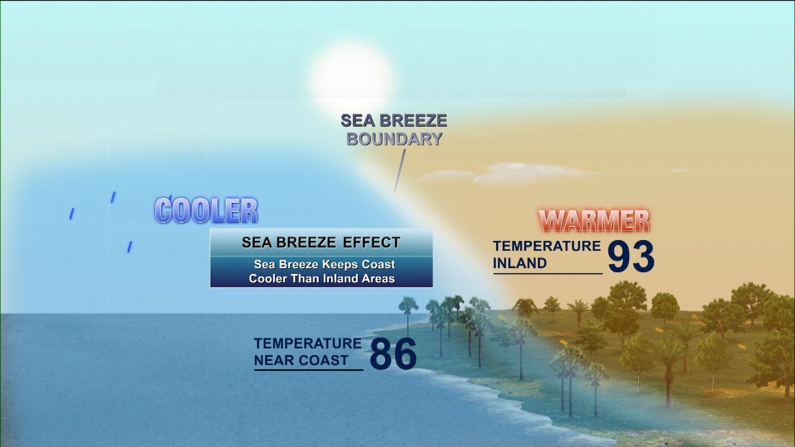
Water Temperature
Since it takes more energy to change the temperature of water relative to land, oceans and lakes are generally cooler than the adjacent land during the day and warmer at night.
These small-scale temperature gradients can lead to changes in atmospheric pressure and wind over an area.
Sea breezes along coastal areas, lake breezes near large lakes. Therefore, coastal areas generally have smaller temperature variations than inland areas.
Water Currents

Slide 4
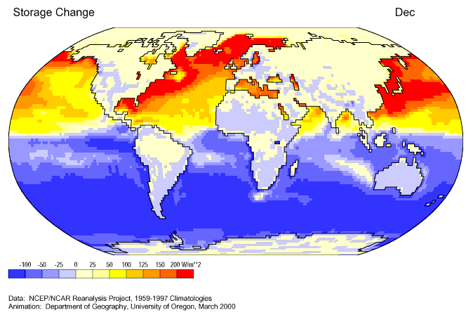
Seasonal Patterns
Large water bodies can also play a role in seasonal temperature patterns, in that water bodies tend to remain cooler during the summer and warmer during the winter relative to land masses.
This process is especially apparent in mid-latitude areas where the amount of solar heating changes substantially over the course of the year.

Slide 5
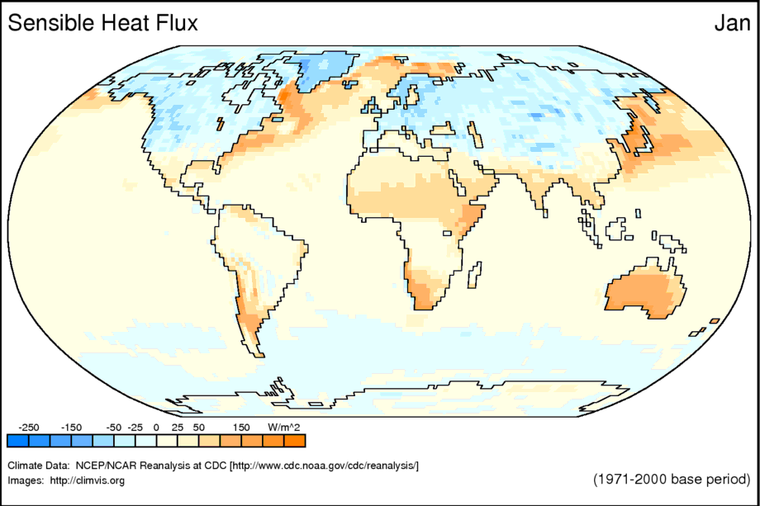
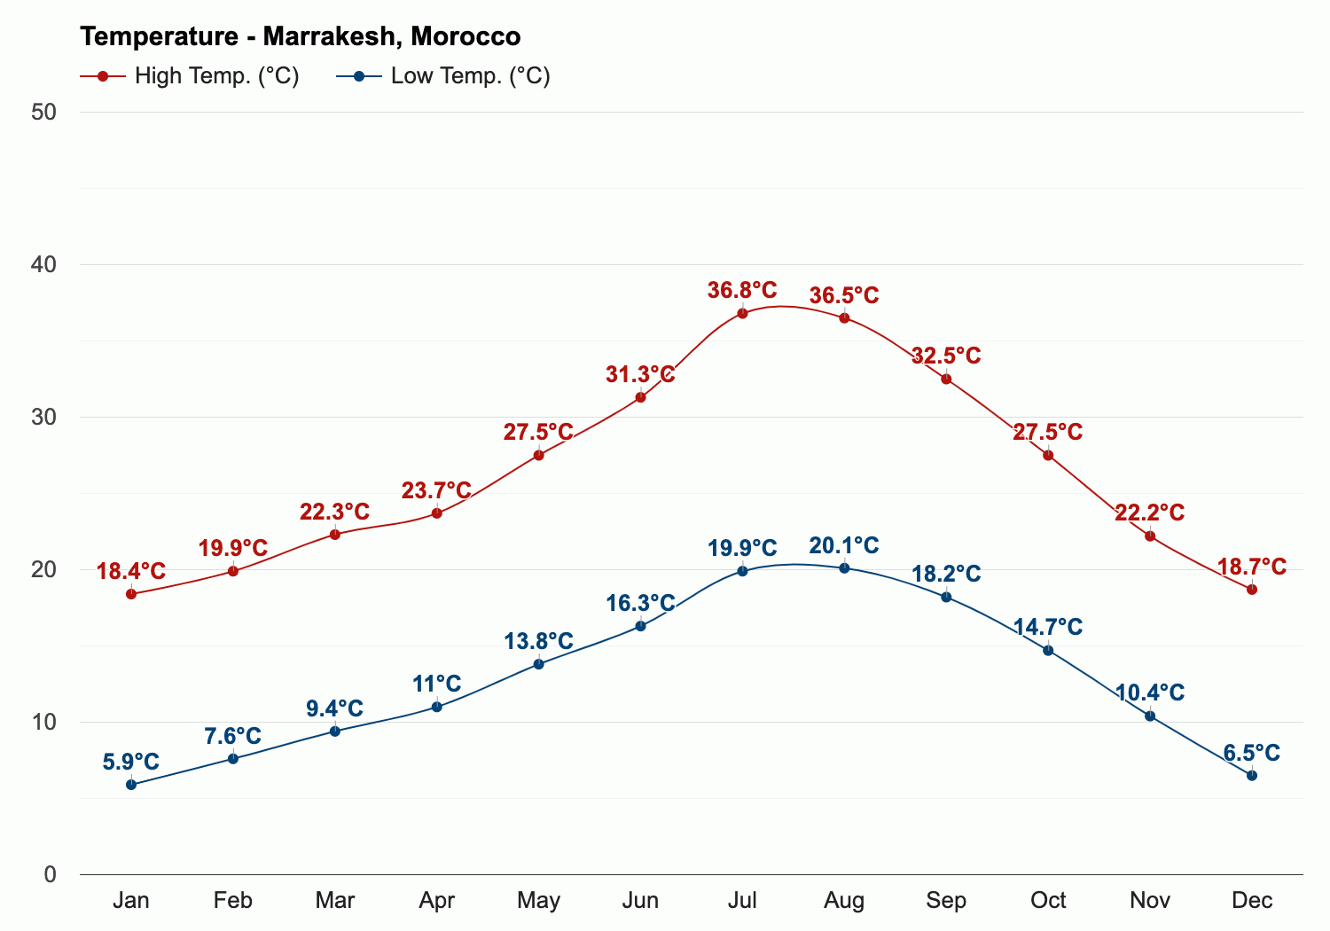
Season Differences
Sensible Heat is a combination of surface and air temperature from the sun heating specific areas.
The Sahara Desert remains warmer for most seasons because of the lack of water in the ground and the sand allows for heat to be stored. During the evenings and cooler seasons,
the dry air allows for temperatures
to drop below 40°F.
The Western Pacific region is made up of mostly islands and remains warm during the winter months because of its relation to the ocean. The ocean surface takes longer to warm and cool; therefore it is warmer in the winter months and cooler in the summer months.

Slide 6
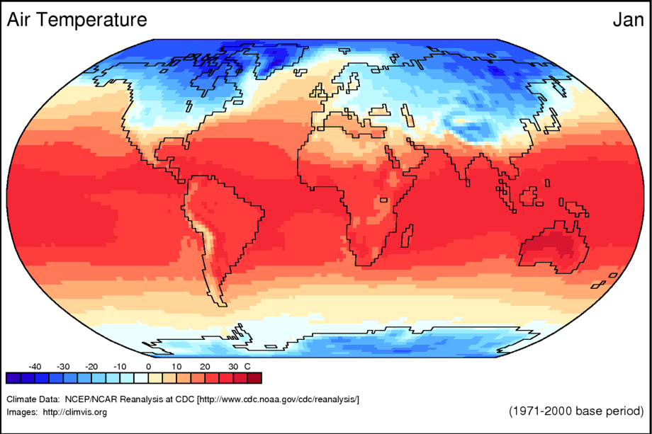
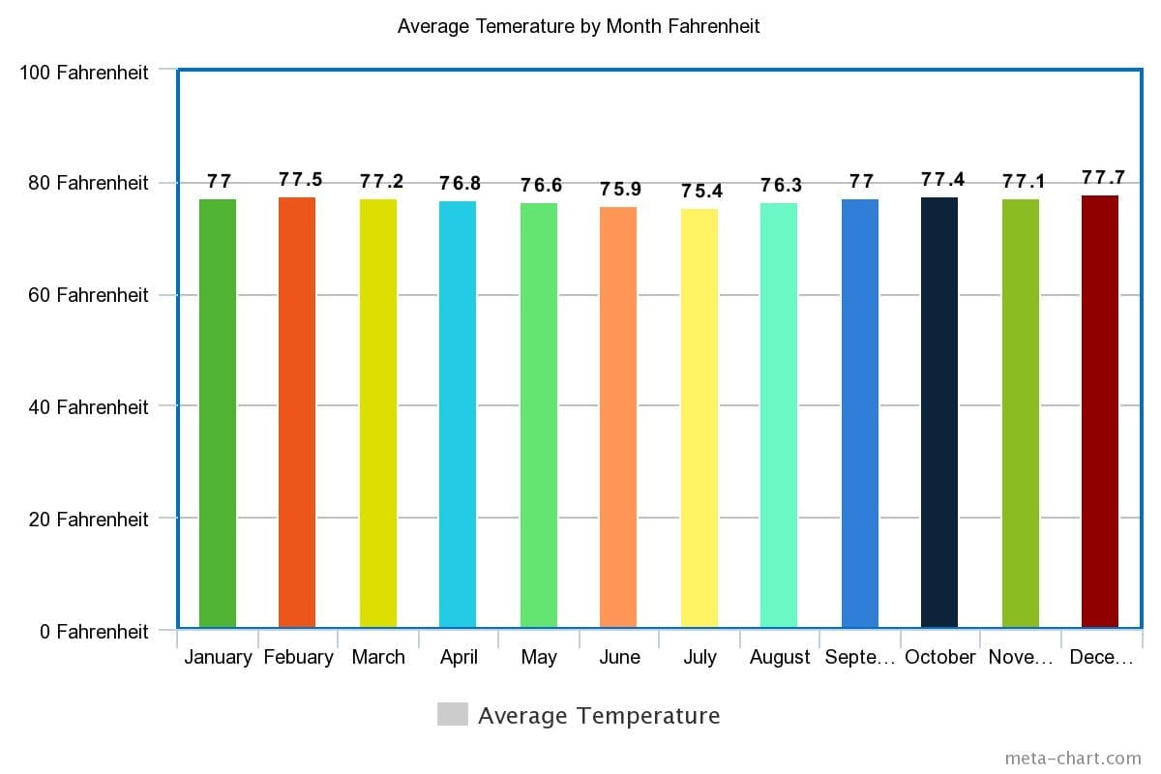
Season Examples
Different areas can have different air temperatures per season depending on where they are located.
The Amazon Region is located near the Equator and receives more sunlight; therefore it retains more solar energy and remains warmer for most of the year.
The Tibetan Plateau remains cooler because its latitude closer to the North Pole and its elevation being higher. Both these properties allow temperatures to reach -40°F in the cooler seasons and remain cool year long.

